Slide 1
Epidemiology and Big Data Mixed Models part 2: Longitudinal Data (Modelling Time)
Rebecca Stellato

Slide 2
Overview Part 2: longitudinal data
Examples of longitudinal data
Linear mixed effects (LME) models with linear time effect
The variance-covariance matrix of repeated measures
Correlation structures & covariance pattern models
What to do with baseline measurement?

Slide 3
Longitudinal Data
Longitudinal data:
variable measured on individual at several time points
observations on one and the same individual will not be independent
calls for special analysis techniques

Slide 4
Examples of Longitudinal Data
Example (Reisby et al.)
66 patients
with or without endogenous depression
depression scores measured weekly at weeks 0 – 5, using Hamilton Depression Rating Scale (HDRS)
from week 1 onwards, patients are treated with imipramine
Research question: is the pattern of HDRS over time different for patients with endogenous and non-endogenous depression?

Slide 5
Examples of Longitudinal Data
Example (Stoop et al. 2012)
14 patients with Hurler syndrome
after haematopoietic stem cell transplantation
various radiologic measurements, including the odontoid/body ratio
Research question: what is the pattern of orthopedic manifestations after stem cell transplant?

Slide 6
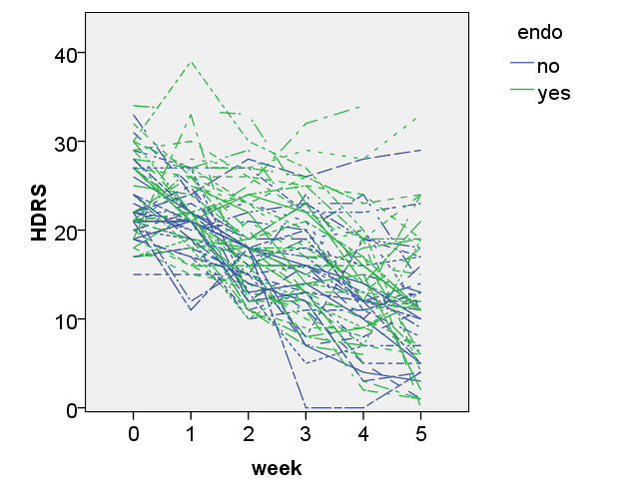
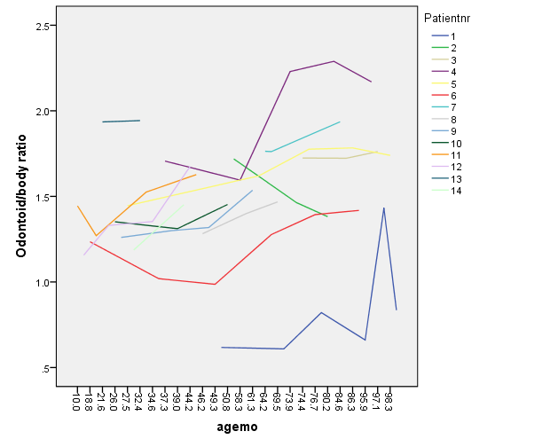
Examples of Longitudinal Data
Reisby et al.
Stoop et al.

Slide 7
Example: Reisby Data
Research question: differing patterns over time for the two groups?
fixed effects for intercept, time, group & group*time
time continuous or categorical?
How to deal with multiple measurements?
Random effects
intercept?
each patient seems to have a different starting point
slope of time?
could be patients have differing slopes over time

Slide 8
Example: Reisby Data
Descriptive Statistics (R)
> reisby.wide <- reshape(reisby.long, v.names="hdrs", idvar="id", timevar="week", direction="wide")
> by(reisby.wide[,3:8], reisby.wide$endo, describe)
endo: 0
var n mean sd median
hdrs.0 1 28 22.79 4.12 22.0
hdrs.1 2 29 20.48 3.83 21.0
hdrs.2 3 28 17.00 4.35 16.5
hdrs.3 4 29 15.34 6.17 16.0
hdrs.4 5 29 12.62 6.72 12.0
hdrs.5 6 27 11.22 6.34 11.0
------------------------------------
endo: 1
var n mean sd median
hdrs.0 1 33 24.00 4.85 24.0
hdrs.1 2 34 23.00 5.10 22.0
hdrs.2 3 37 19.30 6.08 18.0
hdrs.3 4 36 17.28 6.56 16.5
hdrs.4 5 34 14.47 7.17 14.0
hdrs.5 6 31 12.58 7.96 11.0
describe() function in the ‘psych’ package (gives more stats than presented here)

Slide 9
Example: Reisby Data
correlations between HDRS measurements (R)
> round(cor(reisby.wide[,3:8], use="pairwise.complete.obs"), digits=3)
hdrs.0 hdrs.1 hdrs.2 hdrs.3 hdrs.4 hdrs.5
hdrs.0 1.000 0.493 0.410 0.333 0.227 0.184
hdrs.1 0.493 1.000 0.494 0.412 0.308 0.218
hdrs.2 0.410 0.494 1.000 0.738 0.669 0.461
hdrs.3 0.333 0.412 0.738 1.000 0.817 0.568
hdrs.4 0.227 0.308 0.669 0.817 1.000 0.654
hdrs.5 0.184 0.218 0.461 0.568 0.654 1.000

Slide 10
Example: Reisby Data
“Spaghetti Plot” (R, using ggplot2)

Slide 11
Linear time effect
Time technically measured in categories (weeks 1, 2 ...)
Reasonable to model time as linear?
1 parameter for slope of HDRS in time
need to check whether this assumption is reasonable
initial data analysis (spaghetti plot, individual plots)
model comparison (day 3)

Slide 12
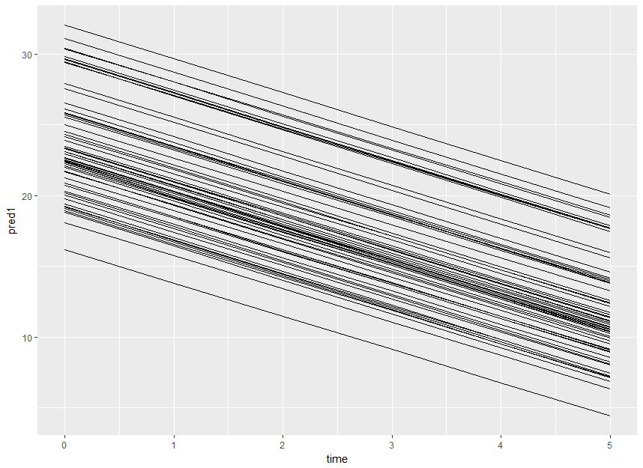
Random intercept with linear time effect
Predicted values from a LME with random intercept and linear time:

Slide 13
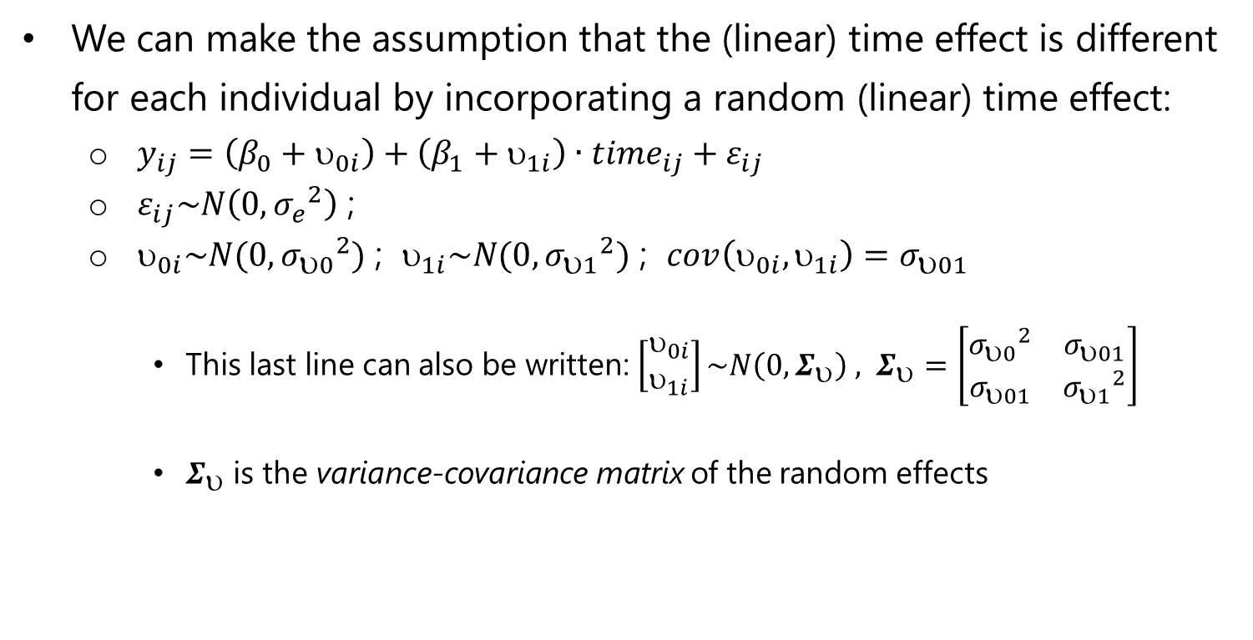
Random intercept + random linear time effect
We can make the assumption that the (linear) time effect is different for each individual by incorporating a random (linear) time effect:
$y_{ij}=\left(β_{0}+υ_{0i}\right)+\left(β_{1}+υ_{1i}\right)∙{time}_{ij}+ε_{ij}$
$ε_{ij}\sim N\left(0,{σ_{e}}^{2}\right)$ ;
$_{0i}\sim N(0,{σ_{υ0}}^{2})$ ; $_{1i}\sim N(0,{σ_{υ1}}^{2})$ ; $cov\left(υ_{0i},υ_{1i}\right)=σ_{υ01}$
This last line can also be written: $\left[\begin{matrix}_{0i} \\ _{1i}\end{matrix}\right]\sim N\left(0, Σ_{}\right) , Σ_{}=\left[\begin{matrix}{σ_{0}}^{2} & σ_{01} \\ σ_{01} & {σ_{1}}^{2}\end{matrix}\right]$
$Σ_{}$ is the variance-covariance matrix of the random effects

Slide 14
R output random intercept + random slope model
Parameter estimates of the fixed part of the previous model:
Value Std.Error DF t-value p-value
(Intercept) 22.476263 0.7986132 307 28.144117 0.0000
time -2.365687 0.3134845 307 -7.546425 0.0000
endo 1.988021 1.0747911 64 1.849681 0.0690
time:endo -0.027056 0.4217258 307 -0.064155 0.9489

Slide 15
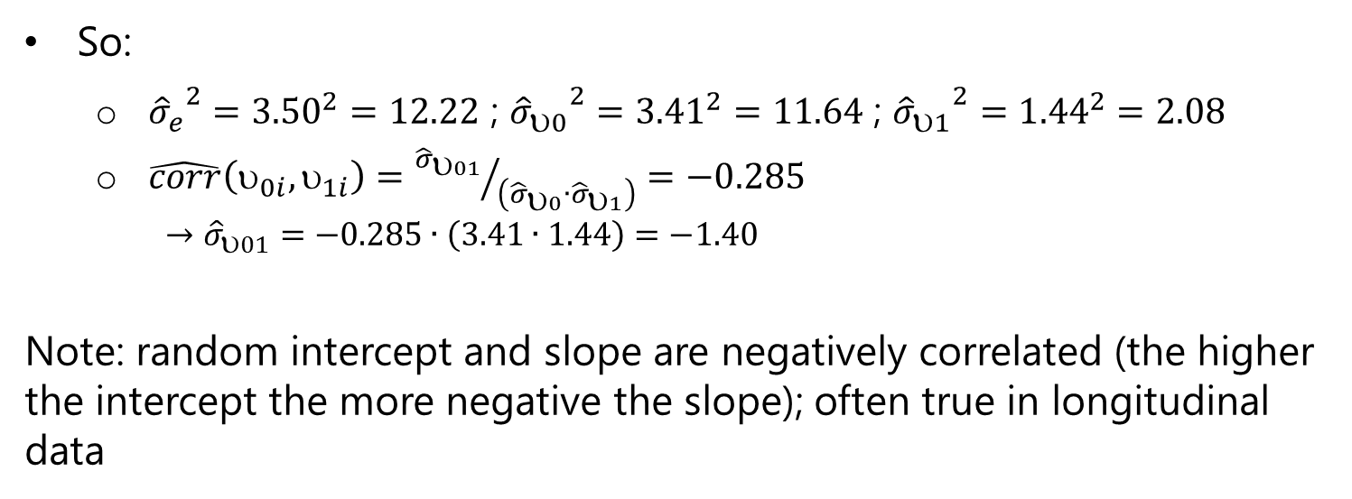
R output random intercept + random slope model
Parameter estimates of the random part (intercept, slope) of the model:
StdDev Corr
(Intercept) 3.411893 (Intr)
time 1.441193 -0.285
Residual 3.495500
So:
${{\hat{σ}}_{e}}^{2}={3.50}^{2}=12.22$ ; ${{\hat{σ}}_{υ0}}^{2}={3.41}^{2}=11.64$ ; ${{\hat{σ}}_{υ1}}^{2}={1.44}^{2}=2.08$
$\hat{corr}\left(_{0i},_{1i}\right)={{\hat{σ}}_{01}}/{\left({\hat{σ}}_{0}∙{\hat{σ}}_{1}\right)}=−0.285$
$$→{\hat{σ}}_{υ01}=−0.285∙\left(3.41∙1.44\right)=−1.40$$
Note: random intercept and slope are negatively correlated (the higher the intercept the more negative the slope); often true in longitudinal data

Slide 16
Interpretation of model
Intercept (22.48) is average HDRS score when all variables = 0
so for patients with exogenous depression (reference) at time = 0
Estimate for endo (1.99) is average difference in HDRS between endogenous and exogenous patients at time = 0
patients with exogenous depression start with average of 22.48
patients with endogenous depression start with average of 22.476 + 1.988 = 24.46
Estimate of random intercept s.d. 3.41 indicates considerable fluctuation around fixed intercepts:
patients can start quite a bit higher/lower than average
“Average” slope is -2.37 for patients with exogenous depression

Slide 17
Interpretation of model, cont.
Interaction endo*time (-0.027) is difference in slope endogenous vs. exogenous
per time unit (1 week) the HDRS score decreases on average by 2.37 (exog)
per time unit (1 week) the HDRS score decreases on average by 2.39 (endog)
Estimate of random slope s.d. 1.44, so for individuals the slope can be quite a bit steeper or flatter, may even be positive for some patients (as seen in the plot).

Slide 18
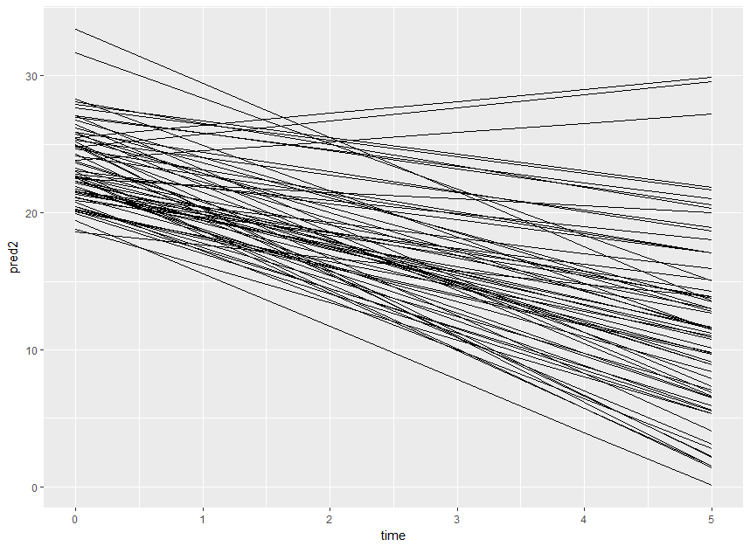
Random intercept + random linear time effect
Predicted values from a LME with random intercept + random linear time effect:

Slide 19
Random intercept + random linear time effect
Given what we learned yesterday, the previous analysis (with linear effects for time) is “all” we could do
What if we think it is unreasonable to use time as continuous?
Add time as categorical to the fixed effects – and then?
some add time as linear to the random effects
others choose to tackle time as a categorical variable in the random part of the model as well

Slide 20
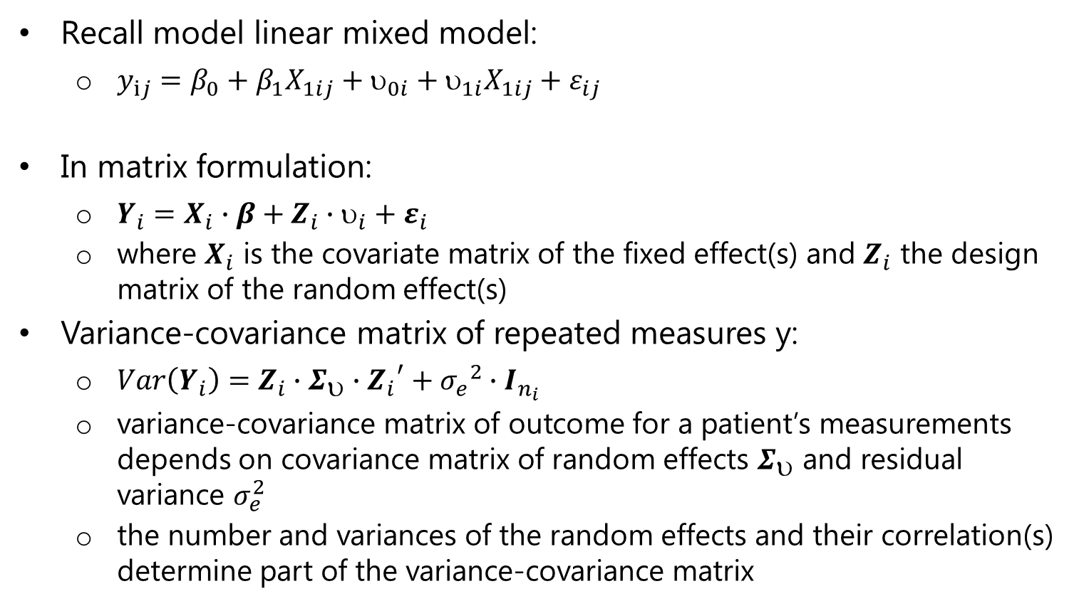
LMM matrix formulation & var-covar matrix
Recall model linear mixed model:
$y_{ij}=β_{0}+β_{1}X_{1ij}+_{0i}+_{1i}X_{1ij}+ε_{ij}$
In matrix formulation:
$Y_{i}=X_{i}∙β+Z_{i}∙_{i}+ε_{i}$
where $X_{i}$ is the covariate matrix of the fixed effect(s) and $Z_{i}$ the design matrix of the random effect(s)
Variance-covariance matrix of repeated measures y:
$Var\left(Y_{i}\right)=Z_{i}∙Σ_{υ}∙{Z_{i}}^{′}+{σ_{e}}^{2}∙I_{n_{i}}$
variance-covariance matrix of outcome for a patient’s measurements depends on covariance matrix of random effects $Σ_{}$ and residual variance $σ_{e}^{2}$
the number and variances of the random effects and their correlation(s) determine part of the variance-covariance matrix

Slide 21
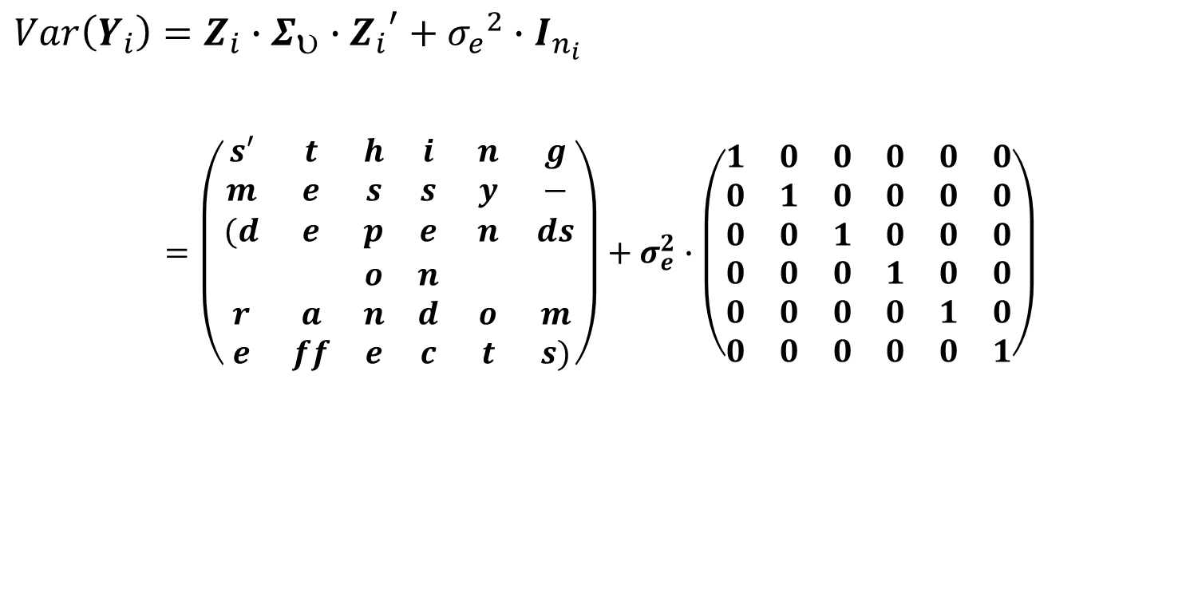
LMM matrix formulation & var-covar matrix
$$Var\left(Y_{i}\right)=Z_{i}∙Σ_{υ}∙{Z_{i}}^{′}+{σ_{e}}^{2}∙I_{n_{i}}$$
$$=\left(\begin{matrix}s′ & t & h & i & n & g \\ m & e & s & s & y & − \\ (d & e & p & e & n & ds \\ & & o & n & & \\ r & a & n & d & o & m \\ e & ff & e & c & t & s)\end{matrix}\right)+σ_{e}^{2}∙\left(\begin{matrix}1 & 0 & 0 & 0 & 0 & 0 \\ 0 & 1 & 0 & 0 & 0 & 0 \\ 0 & 0 & 1 & 0 & 0 & 0 \\ 0 & 0 & 0 & 1 & 0 & 0 \\ 0 & 0 & 0 & 0 & 1 & 0 \\ 0 & 0 & 0 & 0 & 0 & 1\end{matrix}\right)$$

Slide 22
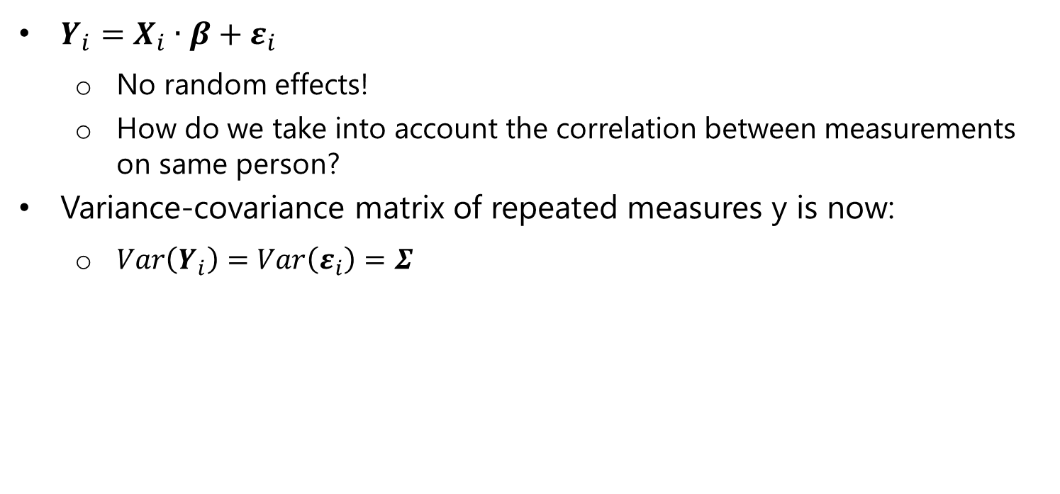
CPMs & var-covar matrix
Another possibility for modelling longitudinal data:
$Y_{i}=X_{i}∙β+ε_{i}$
No random effects!
How do we take into account the correlation between measurements on same person?
Variance-covariance matrix of repeated measures y is now:
$Var\left(Y_{i}\right)=Var\left(ε_{i}\right)=Σ$

Slide 23
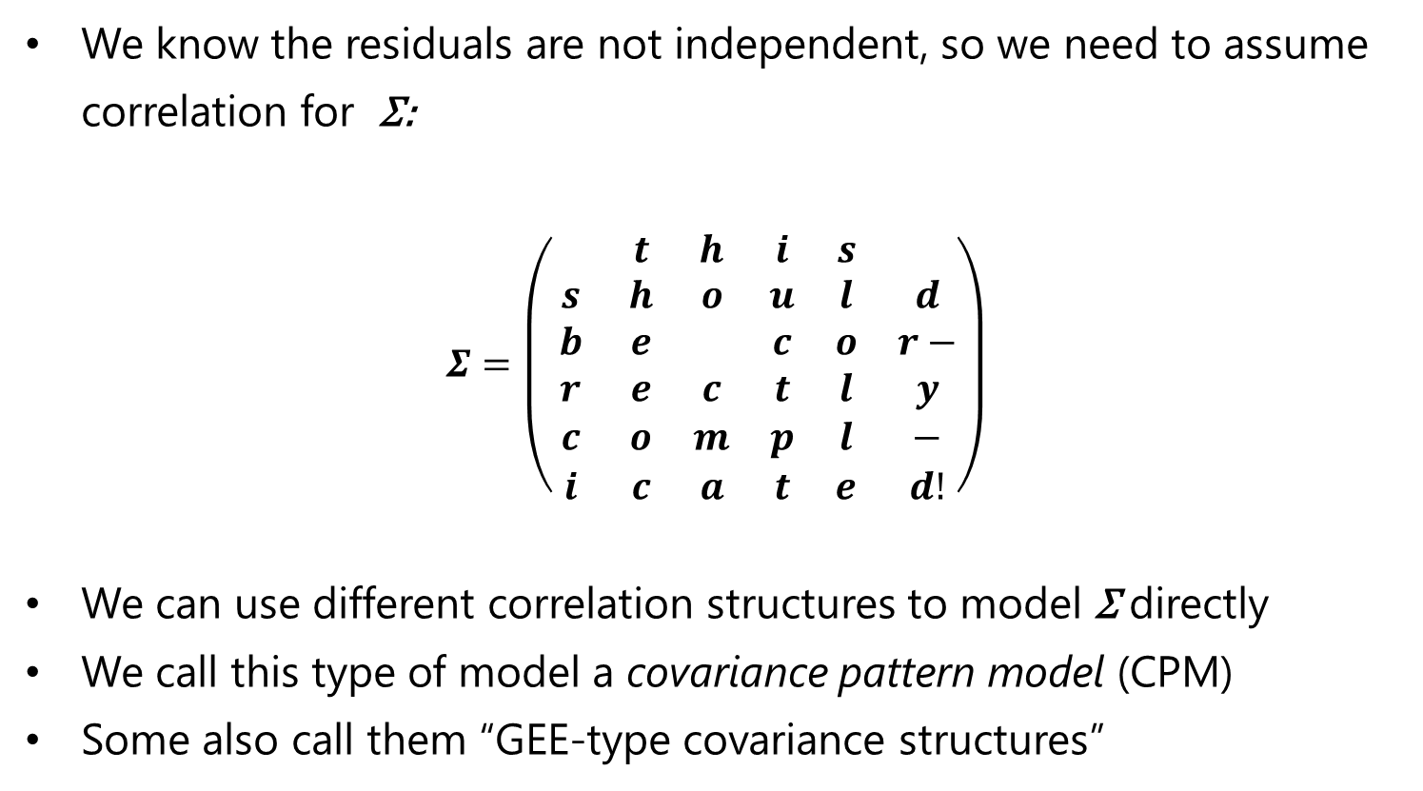
CPMs & var-covar matrix
We know the residuals are not independent, so we need to assume correlation for Σ:
$$Σ=\left(\begin{matrix} & t & h & i & s & \\ s & h & o & u & l & d \\ b & e & & c & o & r− \\ r & e & c & t & l & y \\ c & o & m & p & l & − \\ i & c & a & t & e & d!\end{matrix}\right)$$
We can use different correlation structures to model Σ directly
We call this type of model a covariance pattern model (CPM)
Some also call them “GEE-type covariance structures”

Slide 24
Example: Reisby Data
Possibilities for modelling correlated measures
Model correlation of measurements implicitly (linear mixed effects model):
repeated observations are level-1 variables nested within patient (=level 2)
random intercept per patient or random intercept per patient + random slope for week per patient or...
random effects and their covariance determine structure of var-covar matrix
Model correlation of measurements explicitly (CPM):
incorporate a covariance structure of the residuals into the model
(usually) assumes equally spaced time intervals
Combination of the two (mixed regression models with autocorrelated errors)

Slide 25
Observed var-cov matrix Reisby dataset
> round(var(reisby.wide[,3:8], use="pairwise.complete.obs"), digits = 2)
hdrs.0 hdrs.1 hdrs.2 hdrs.3 hdrs.4 hdrs.5
hdrs.0 20.55 10.11 10.14 10.09 7.19 6.28
hdrs.1 10.11 22.07 12.28 12.55 10.26 7.72
hdrs.2 10.14 12.28 30.09 25.13 24.63 18.38
hdrs.3 10.09 12.55 25.13 41.15 37.34 23.99
hdrs.4 7.19 10.26 24.63 37.34 48.59 30.51
hdrs.5 6.28 7.72 18.38 23.99 30.51 52.12

Slide 26
Various correlation structures
nlme has numerous correlation structures for linear mixed models
Most common/realistic for longitudinal data
unstructured
autoregressive of order 1: AR(1)
Bad ideas:
uncorrelated (independent)
compound symmetry
Correlations pertain to the residuals within each of the subjects after correcting for fixed (and perhaps random) effects

Slide 27
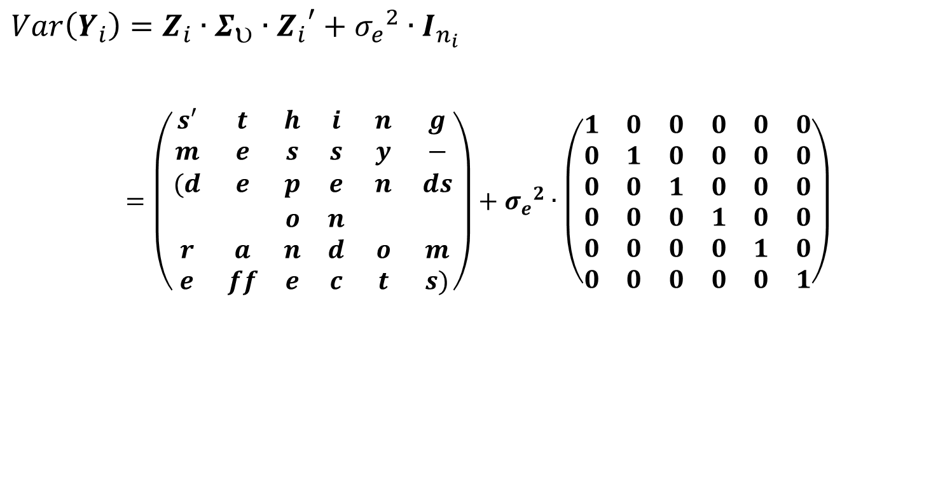
Independent correlation structure
The independent (scaled identity) correlation structure assumes residuals to be independent, as if they came from different subjects
All variances are assumed equal, all correlations are assumed 0
This is the assumption in ordinary linear regression/ANOVA
Σ $=\left(\begin{matrix}σ^{2} & 0 & 0 & 0 & 0 & 0 \\ 0 & σ^{2} & 0 & 0 & 0 & 0 \\ 0 & 0 & σ^{2} & 0 & 0 & 0 \\ 0 & 0 & 0 & σ^{2} & 0 & 0 \\ 0 & 0 & 0 & 0 & σ^{2} & 0 \\ 0 & 0 & 0 & 0 & 0 & σ^{2}\end{matrix}\right)=σ^{2}∙\left(\begin{matrix}1 & 0 & 0 & 0 & 0 & 0 \\ 0 & 1 & 0 & 0 & 0 & 0 \\ 0 & 0 & 1 & 0 & 0 & 0 \\ 0 & 0 & 0 & 1 & 0 & 0 \\ 0 & 0 & 0 & 0 & 1 & 0 \\ 0 & 0 & 0 & 0 & 0 & 1\end{matrix}\right)$

Slide 28
Independent correlation structure
Analyzing the data from the Reisby example using time (categorical), tx and time*tx and an independent correlation structure amounts to doing a two-way ANOVA (all observations are assumed to be independent)
Even when observations are in fact (nearly) independent, the design of the study was to take random patients, and measure these multiple times, not to take random samples at each time point
Preferable to analyze data as being repeated (and thus correlated)!

Slide 29
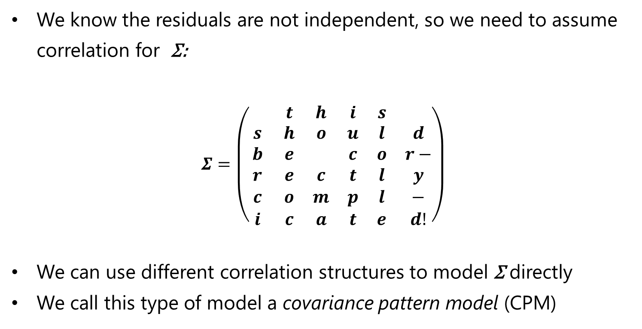
Compound symmetry correlation structure
The compound symmetry (exchangeable) correlation structure assumes correlations between all time points to be equal, irrespective of the length of the time intervals.
All variances are assumed equal, all correlations too:
$$\left(\begin{matrix}σ^{2}+{σ_{0}}^{2} & {σ_{0}}^{2} & {σ_{0}}^{2} & {σ_{0}}^{2} & {σ_{0}}^{2} & {σ_{0}}^{2} \\ {σ_{0}}^{2} & σ^{2}+{σ_{0}}^{2} & {σ_{0}}^{2} & {σ_{0}}^{2} & {σ_{0}}^{2} & {σ_{0}}^{2} \\ {σ_{0}}^{2} & σ^{2} & σ^{2}+{σ_{0}}^{2} & {σ_{0}}^{2} & {σ_{0}}^{2} & {σ_{0}}^{2} \\ {σ_{0}}^{2} & {σ_{0}}^{2} & {σ_{0}}^{2} & σ^{2}+{σ_{0}}^{2} & {σ_{0}}^{2} & {σ_{0}}^{2} \\ {σ_{0}}^{2} & {σ_{0}}^{2} & {σ_{0}}^{2} & {σ_{0}}^{2} & σ^{2}+{σ_{0}}^{2} & {σ_{0}}^{2} \\ {σ_{0}}^{2} & {σ_{0}}^{2} & {σ_{0}}^{2} & {σ_{0}}^{2} & {σ_{0}}^{2} & σ^{2}+{σ_{0}}^{2}\end{matrix}\right)=\left({σ_{0}}^{2}+σ^{2}\right)\left(\begin{matrix}1 & ρ & ρ & ρ & ρ & ρ \\ ρ & 1 & ρ & ρ & ρ & ρ \\ ρ & ρ & 1 & ρ & ρ & ρ \\ ρ & ρ & ρ & 1 & ρ & ρ \\ ρ & ρ & ρ & ρ & 1 & ρ \\ ρ & ρ & ρ & ρ & ρ & 1\end{matrix}\right)$$
Note: $ρ={{σ_{0}}^{2}}/{\left({σ_{0}}^{2}+σ^{2}\right)}$, with ${σ_{0}}^{2}$ the variance within patients
ρ is then known as the intraclass correlation coefficient, a ratio of individual variance to total variance

Slide 30
Compound symmetry correlation structure
A covariance pattern model with a compound symmetry pattern for the residuals is equivalent to a linear mixed model with a random intercept per patient
when we treat time as categorical in the fixed parts of both models
For data without missing values, these two models are also equivalent to a repeated measures (“split-plot”) ANOVA

Slide 31
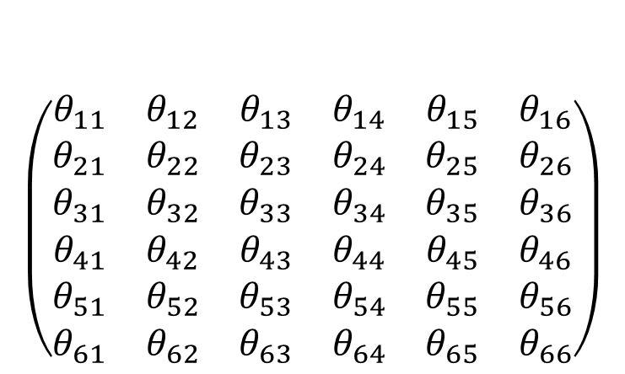
Unstructured correlation
$$\left(\begin{matrix}θ_{11} & θ_{12} & θ_{13} & θ_{14} & θ_{15} & θ_{16} \\ θ_{21} & θ_{22} & θ_{23} & θ_{24} & θ_{25} & θ_{26} \\ θ_{31} & θ_{32} & θ_{33} & θ_{34} & θ_{35} & θ_{36} \\ θ_{41} & θ_{42} & θ_{43} & θ_{44} & θ_{45} & θ_{46} \\ θ_{51} & θ_{52} & θ_{53} & θ_{54} & θ_{55} & θ_{56} \\ θ_{61} & θ_{62} & θ_{63} & θ_{64} & θ_{65} & θ_{66}\end{matrix}\right)$$
Variances at each time point different
All covariances among time points different (note that θ₁₂ = θ₂₁)
Costly structure: 21 df needed for 6 time points!
Flexible structure

Slide 32
Unstructured correlation for Reisby data
Estimated from model with time (cat), endo & time*endo, no random effects
[,1] [,2] [,3] [,4] [,5] [,6]
[1,] 19.63 10.40 6.34 8.09 6.73 4.50
[2,] 10.40 20.87 10.26 10.69 8.33 5.02
[3,] 6.34 10.26 25.90 22.36 23.99 20.88
[4,] 8.09 10.69 22.36 38.44 32.03 29.90
[5,] 6.73 8.33 23.99 32.03 46.89 38.77
[6,] 4.50 5.02 20.88 29.90 38.77 60.19

Slide 33
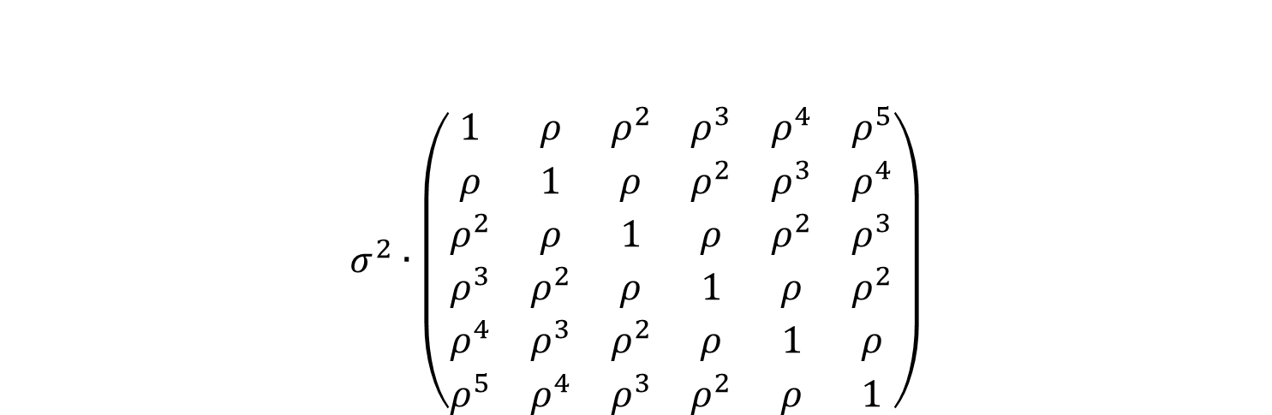
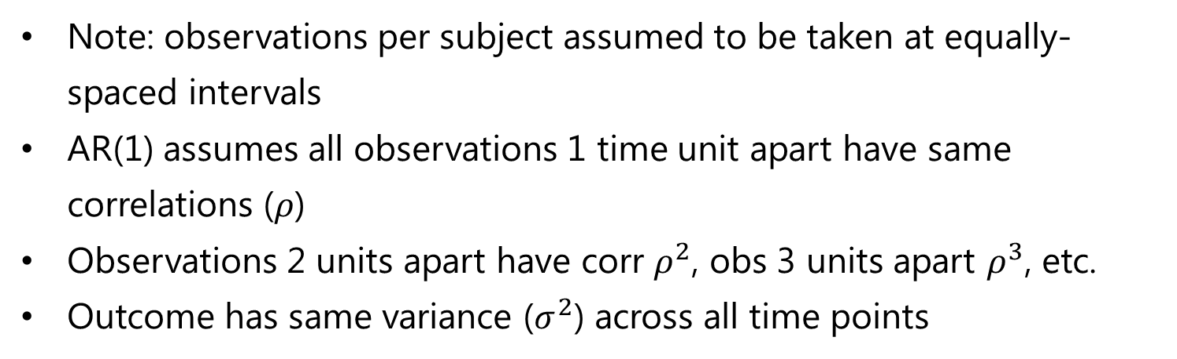
(Homogeneous) autoregressive of order 1 (AR1) correlation
$$σ^{2}∙\left(\begin{matrix}1 & ρ & ρ^{2} & ρ^{3} & ρ^{4} & ρ^{5} \\ ρ & 1 & ρ & ρ^{2} & ρ^{3} & ρ^{4} \\ ρ^{2} & ρ & 1 & ρ & ρ^{2} & ρ^{3} \\ ρ^{3} & ρ^{2} & ρ & 1 & ρ & ρ^{2} \\ ρ^{4} & ρ^{3} & ρ^{2} & ρ & 1 & ρ \\ ρ^{5} & ρ^{4} & ρ^{3} & ρ^{2} & ρ & 1\end{matrix}\right)$$
Note: observations per subject assumed to be taken at equally-spaced intervals
AR(1) assumes all observations 1 time unit apart have same correlations ($ρ$)
Observations 2 units apart have corr $ρ^{2}$, obs 3 units apart $ρ^{3}$, etc.
Outcome has same variance ($σ^{2}$) across all time points

Slide 34
AR1 with homogeneous variances for Reisby data
Estimated from model with time (cat), tx & time*tx, no random effects
[,1] [,2] [,3] [,4] [,5] [,6]
[1,] 35.0510 23.1050 15.231 10.040 6.6183 4.3627
[2,] 23.1050 35.0510 23.105 15.231 10.0400 6.6183
[3,] 15.2310 23.1050 35.051 23.105 15.2310 10.0400
[4,] 10.0400 15.2310 23.105 35.051 23.1050 15.2310
[5,] 6.6183 10.0400 15.231 23.105 35.0510 23.1050
[6,] 4.3627 6.6183 10.040 15.231 23.1050 35.0510
Standard Deviations: 5.9204 5.9204 5.9204 5.9204 5.9204 5.9204

Slide 35
AR1 with heterogeneous variances for Reisby data
Estimated from model with time (cat), tx & time*tx, no random effects
[,1] [,2] [,3] [,4] [,5] [,6]
[1,] 22.98 16.29 11.18 7.76 5.42 4.09
[2,] 16.29 27.12 18.62 12.92 9.02 6.81
[3,] 11.18 18.62 30.05 20.85 14.56 10.99
[4,] 7.76 12.92 20.85 33.98 23.73 17.91
[5,] 5.42 9.02 14.56 23.73 38.92 29.38
[6,] 4.09 6.81 10.99 17.91 29.38 52.11
Heterogeneous variances probably fit the data better

Slide 36
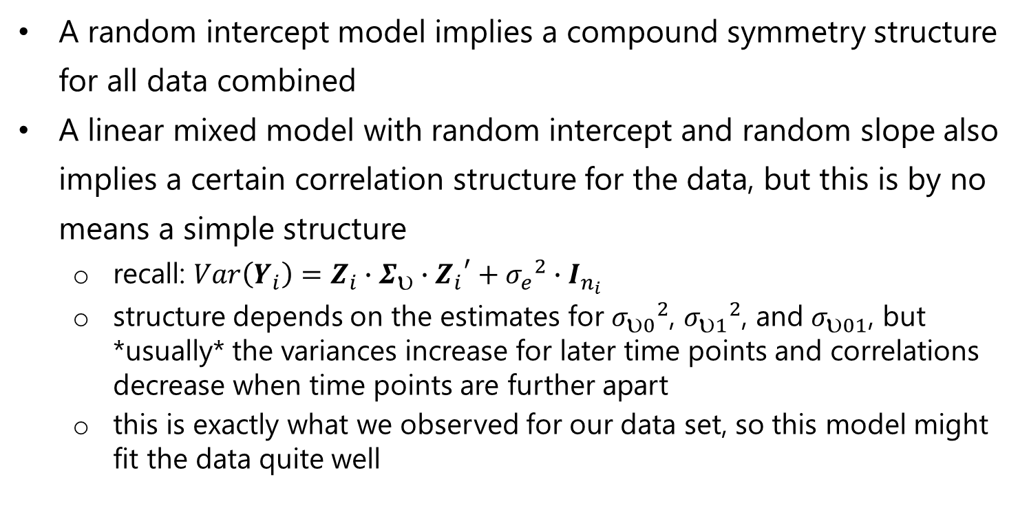
“Covariance patterns” of linear mixed models
A random intercept model implies a compound symmetry structure for all data combined
A linear mixed model with random intercept and random slope also implies a certain correlation structure for the data, but this is by no means a simple structure
recall: $Var\left(Y_{i}\right)=Z_{i}∙Σ_{υ}∙{Z_{i}}^{′}+{σ_{e}}^{2}∙I_{n_{i}}$
structure depends on the estimates for ${σ_{0}}^{2}$, ${σ_{1}}^{2}$, and $σ_{01}$, but *usually* the variances increase for later time points and correlations decrease when time points are further apart
this is exactly what we observed for our data set, so this model might fit the data quite well

Slide 37
Covariance patterns linear mixed models
Random intercept + random slope model (fixed time categorical):
Marginal variance covariance matrix
1 2 3 4 5 6
1 23.8600 10.239 8.838 7.4364 6.0349 4.6334
2 10.2390 23.134 11.590 12.2660 12.9420 13.6170
3 8.8380 11.590 26.562 17.0960 19.8480 22.6010
4 7.4364 12.266 17.096 34.1440 26.7550 31.5840
5 6.0349 12.942 19.848 26.7550 45.8800 40.5680
6 4.6334 13.617 22.601 31.5840 40.5680 61.7700

Slide 38
Back to Stoop, et al.
How would we model data from Stoop, et al.?
time: discreet or continuous?
LME or CPM?
time: linear? quadratic?
Theory vs. practice....

Slide 39
What to do with baseline measurement?
In clinical trials, a baseline measurement of outcome often taken before randomization
Is baseline an “outcome”?
yes: use as first outcome measurement in mixed model?
no: ignore?
no: use as covariate in model?
In an observational study, there is no experimental intervention
Usually then “baseline” is the first of the measured outcomes
In Reisby example, baseline HDRS is before patients are treated, but there is no randomization
Is baseline HDRS an outcome?

Slide 40
Reisby Example, use baseline HDRS as covariate
Select only time >0, use hdrs.base as covariate in mixed model with random intercept, random slope, fixed time & endo
What do you expect will happen to:
…the estimate of the fixed intercept?
Intercept is now avg HDRS for time = 0, baseline HDRS = 0, endo = 0
Estimate reduces from 24.5 to 11.4
…the estimate of the fixed effect of endo?
…the estimate of the fixed effect of time?
Intercept is now avg HDRS for time = 0, baseline HDRS = 0, endo = 0

Slide 41
Reisby Example, use baseline HDRS as covariate
Select only time >0, use hdrs.base as covariate in mixed model with random intercept, random slope, fixed time & endo
What do you expect will happen to:
…the variance of the random intercept?
Will baseline HDRS explain variation in intercepts between patients
Estimate reduces from 16.0 to 10.1
…the variance of the random slope?
Will baseline HDRS explain variation in slopes between patients
Estimate remains much the same

Slide 42
Summary longitudinal data
Longitudinal data is a specific form of multilevel data
measurements within patients, challenge is in modelling time properly
Time can be continuous or discrete
discrete: everyone measured at a few specific time points
but, with 3+ measurements per person and approximately linear time trends, you could still consider modelling data as continuous
continuous: measurements at different times for different individuals
We can account for correlation of measurements over time
explicitly: variance-covariance matrix of residuals (CPMs)
primarily when everyone (theoretically) measured at same time points
implicitly: random intercept, random slope for time (LMEs)
(both explicitly & implicitly: LMEs with autocorrelated errors)
“Baseline” measurement of outcome has different meaning depending on study design

